Slide 1
Music Recommendation Engine
Northeastern University: College of Professional Studies
Subject: EAI6010 – Applications Of Artificial Intelligence
Submitted to Professor: Sergiy Shevchenko
Date : 06/24/2025
Group Members:
Ayush Anand
Mohammed Anjal
Mohit
Sangayya Hiremath
Saurav Divakar
Shashikanth

Slide 2
Project Overview
🎯 Objective: To build a music recommendation system that suggests similar songs based solely on audio features — without requiring user history or preferences.
✅ Built a content-based song recommendation engine
🎵 Input: Select a song to find similar kind of songs
🎶 Output: Top-5 similar songs based on audio characteristics
🧠 Algorithm: k-Nearest Neighbors (k-NN) using cosine similarity
🌐 Deployment: FastAPI backend serving RESTful endpoints

Slide 3
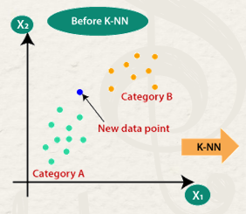
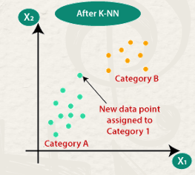
k-NN Model – Finding Similar Songs
📌 Algorithm:
Implemented using NearestNeighbors from scikit-learn
Trained on scaled audio features (e.g., energy, danceability, tempo, etc.)
📏 Distance Metric:
Cosine Similarity measures the angle between feature vectors
More effective than Euclidean distance for high-dimensional data
Songs with smaller angles (higher cosine similarity) are considered more similar
🔁 How It Works:
For a given song ID, the model:
Finds its feature vector
Computes cosine distances to all other songs
Retrieves Top-N closest songs based on smallest distance values
💡 Insight: This unsupervised model requires no labels or prior training,
making it ideal for cold-start music recommendation.

Slide 4
Educational Tools & Music Discovery Platforms
Context:
Music educators and discovery apps aim to expose users to new genres, artists, or musical structures.
How Our Engine Helps:
🎼 Recommends songs based on underlying musical features, great for learning by listening.
🔍 Enables exploration across diverse genres by surfacing lesser-known tracks with similar characteristics.
🧑‍🏫 Can be used in music theory apps to demonstrate variations in tempo, key, or valence through real examples.
Use Case:
An interactive learning app can use the engine to suggest “similar-sounding” tracks when teaching concepts like harmony or rhythm, making theory more tangible.

Slide 5
Business & Retail Environments
Context:
Modern music streaming platforms thrive on delivering tailored listening experiences.
How Our Engine Helps:
🎵 Recommends songs based on musical characteristics (e.g., tempo, energy, valence) — not just user history.
🧠 Can be integrated into new or existing apps to provide discovery even without prior user data.
🔄 Enables dynamic, mood-based playlists (e.g., “Chill Vibes”, “Workout Energy”).
Use Case:
A startup streaming app can use this model to offer first-time users relevant tracks immediately, no sign-up friction or cold start problem.

Slide 6
Dataset & Preprocessing
📊 Dataset Summary
Source: Spotify Dataset with 232,000 tracks
Key fields: (Total 18 Columns)
Metadata: track_name, artist_name, genre, track_id
Audio Features: danceability, energy, tempo, valence, loudness, etc.
Popularity score added to enhance relevance
🧼 Preprocessing Steps
Filled missing values (track_name, mode, etc.)
Converted categorical fields to numeric:
key: e.g., C → 0, G → 7
mode: Minor → 0, Major → 1
Extracted numeric time_signature
⚖️ Feature Scaling
StandardScaler used to normalize feature values
Ensures fair contribution of all features in distance calculation
Final vector: 14 normalized features (e.g., tempo, loudness, popularity, etc.)

Slide 7
How Recommendations Work
📥 Input: Select a song from the list and click on recommendations
⚙️ Behind the Scenes:
Locate feature vector(s) for input track(s)
Use cosine similarity to measure distance from every other song
Sort and return the Top-5 most similar songs
Exclude input tracks from the result to avoid self-recommendation
📤 Output: A ranked list of songs including: track_name, artist_name, genre, distance (similarity score)
💡 Why This Works:
Enables recommendations without needing user preferences
Focuses purely on the audio profile of songs, ideal for discovery of similar-sounding tracks
Fast and scalable with precomputed vector space

Slide 8

Live Demo Access
🔗 Try it yourself: URL: https://sensible-electric-treefrog.ngrok-free.app/
🧭 Features on the Interface:
🎵 Search and select a song by name
📩 Click “Recommend” to get similar songs
🔄 Top-5 results appear instantly with similarity scores

Slide 9
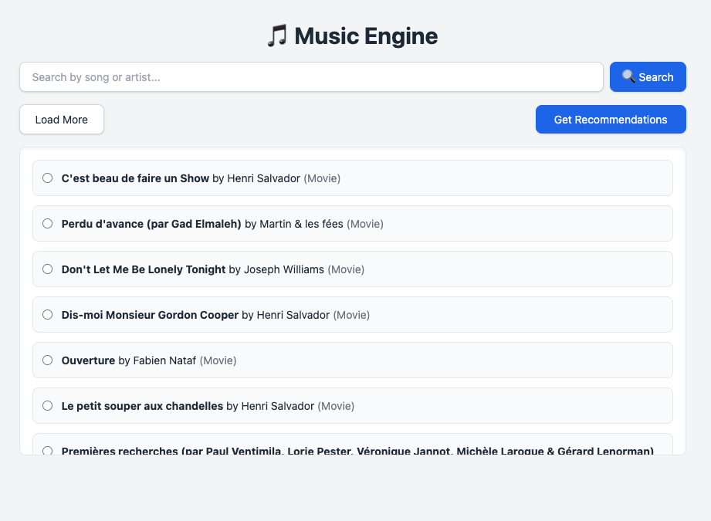
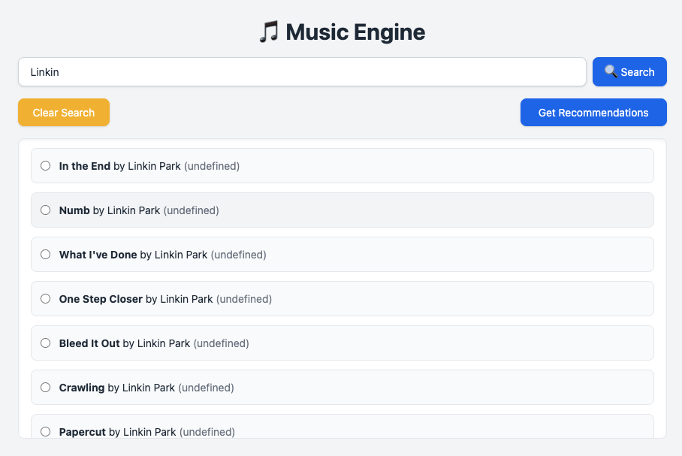
Input Interface
🔍 Step 1: Select a song
🔘 Step 2: Click on "Get Recommendations"

Slide 10
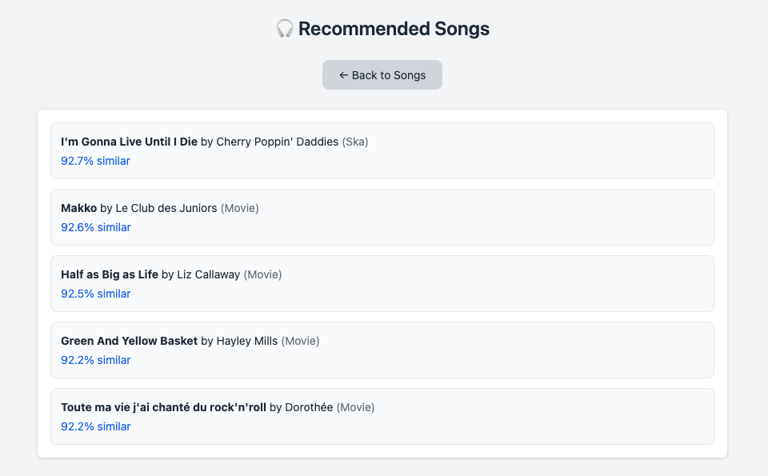
Output/ Recommendations Interface
A list view showing top 5 recommended songs with similarity rate

Slide 11
Next Steps & Enhancements
🔁 Autoencoders: Reduce dimensionality and improve clustering of songs
👥 Hybrid Approach: Combine with collaborative filtering for personalized suggestions
☁️ Cloud Deployment: Host API and build a web interface for broader access
🧪 A/B Testing: Evaluate effectiveness of recommendations on real users

Slide 12
Conclusion
✅ Key Benefits:
Content-Based: Works solely on audio features — no user history needed
Cold-Start Friendly: Recommends songs even for new or unknown users
Scalable: Efficiently handles large-scale data (4.2M tracks)
Explainable: Easy to interpret how recommendations are made based on song features
🎧 Real-World Applications:
Personalized discovery in music streaming platforms
Automated playlist generation tools
Music similarity search for DJs and creators
Enhancing user engagement via "similar songs" feature

Slide 13
References
Spotify Dataset (Million Song Dataset): http://millionsongdataset.com/pages/getting-dataset/
scikit-learn Documentation – NearestNeighbors: https://scikit-learn.org/stable/modules/generated/sklearn.neighbors.NearestNeighbors.html
FastAPI – Modern Web Framework for APIs: https://fastapi.tiangolo.com/
Spotify API (for audio features): https://developer.spotify.com/documentation/web-api/reference/get-audio-features
Pandas & NumPy Documentation: https://pandas.pydata.org/docs/, https://numpy.org/doc/

Slide 14
Thank You!
Any questions?

